Slide 1
HCI DESIGN CHALLENGE GROUP #29
Live on Sunshine
ASHUTOSH PANDA – DURGESH NANDAN – MALIK OSENI – ROHAN BHUJBAL – VEDANT PARAB

Slide 2
PHASES OF DEVELPPMENT
01
02
03
04
PHASE 1
PHASE 2
Ideation
Empathize
PHASE 3
PHASE 4
Design
Conclusion
Table of Contents

Slide 3
01
PHASE 1 Problem Statement Brainstorming, Filter and Finalising Ideas,

Slide 4
PROBLEM STATEMENT
Climate change, driven by global warming and increased carbon emissions, poses a major threat. Local actions of millions contribute to displacement, resource competition, and disruption. Individuals, feeling their impact is limited, seek effective ways to address this complex issue.
The "think global, act local" mantra suggests a solution. However, implementing impactful local actions—such as reducing emissions, conserving energy, and promoting recycling—requires innovative approaches. Solutions include optimizing transportation, reducing dependencies on high-emission industries, and fostering self-sufficiency in energy and food.

Slide 5
PROBLEM STATEMENT CONT.
To empower individuals in mitigating climate change locally, innovative solutions are needed to bridge the gap between global challenges and individual actions.

Slide 6
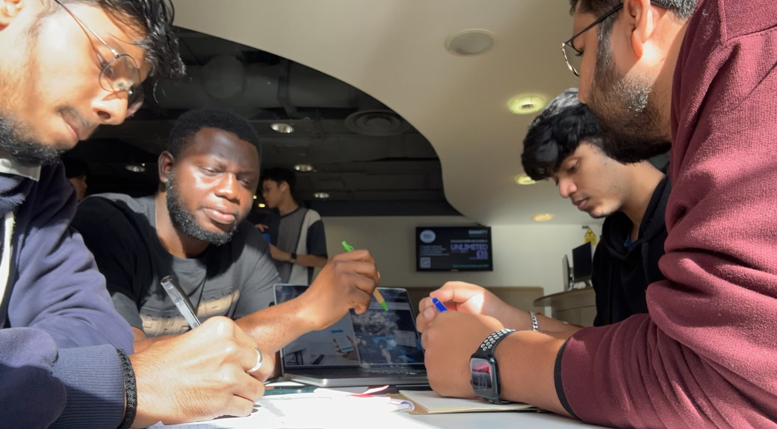

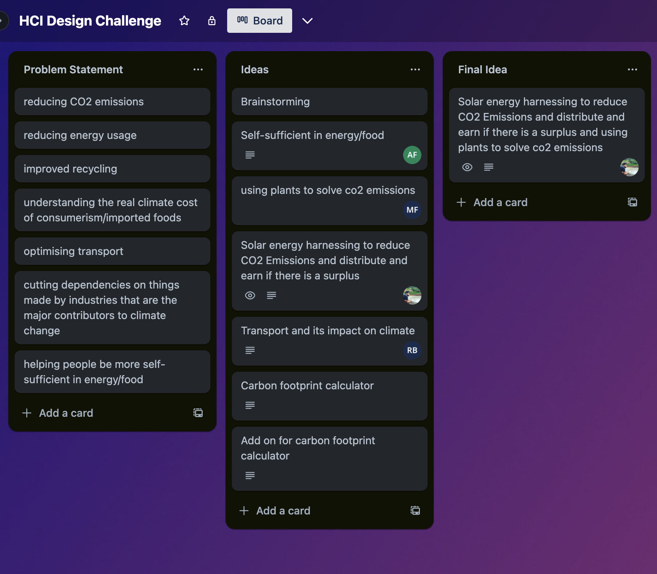
Brainstorming
Since we needed a solution that can help solve the ‘Climate change’ problem. The group started thinking about a solution which could help the cause. As each member of the group produced distinct ideas, we had to define them clearly and pick one which seemed the best idea.

Slide 7
Filtering Ideas
We went through a few brainstorming sessions and everyone in the team produced distinct ideas. This helped us to decide which idea should we go ahead with keeping in mind that it should reflect on the problem statement defined. We also had to investigate the feasibility of the solution and the market demography of the requirement of the product.
Self Sustainable Home
App with guided learning to the kitchen maintenance, gardening, and cooking using less energy.
Sustainable Transport
Find alternative ways to commute using carpooling, bikes, and EV vehicles, with route plan and journey planner
Carbon Footprint Calculator
Calculator that monitors individual contribution to carbon emission to make them aware.
Solar Tracker
Tracks the harnessing, usage, storage, and redistribution
Gardening App
A gamified app which uses VR and AI to promote home gardening and educate users about all aspects of gardening along with rewards for better engagement

Slide 8
Initial Idea
We decided to go ahead with the Solar tracker first as It was promising but the idea was too generic and there were organisations which are providing similar solutions to the customers.
Enphase
Enlighten
But they were not available across most regions are are relatively expensive. Also, the user engagement was less as there were not much of extra features, or gamifications involved.
[1] Enphase : https://enphase.com
[2] Enlighten : https://www.enlightensolar.energy/

Slide 9
Final Idea
In formulating our ultimate concept, we carefully evaluated
the initial two ideas, focusing on the central problem
statement and determining which one more effectively
addressed it.
The Solar Tracker concept involved monitoring individual
home energy consumption. Any surplus energy could be
shared among those in need, offering cash rewards. This
approach aimed to reduce power outages and provide clean
energy for those unable to afford solar installations,
subsequently reducing reliance on generators and
associated CO2 pollution.
The Gardening/Agricultural App explored IoT's potential to
collect plant health data through sensory devices, measuring
variables such as soil moisture, pH balance, and received
UV radiation.

Slide 10
Final Idea cont.
Recognizing the strengths of both ideas, we devised a
synergistic approach through gamification. In this system,
users can trade and share energy, acquire gardening skills,
and support farmers to enhance yields, all while earning
reward tokens for completing gardening tasks. This
integrated solution addresses the initial problem statement
and leverages the strengths of both concepts.

Slide 11
02
PHASE 2 Background Research, Understanding Users and Personas

Slide 12
Background Research
In our research, we narrowed our focus to India and Nigeria as our primary countries of interest. Our examination, based on statistics from each country, delved into their solar and electrical distributions, government support, the nature of blackouts and disasters, and the impact of Gamification on gardening.
Energy Data Study for India:
As of 2021, India stands as the fourth-largest global player in solar energy generation, boasting a capacity of 71.61GW AC.
With approximately 300 clear and sunny days annually, India possesses a remarkable solar potential of 5000 trillion kWh, surpassing its current energy output.
Bengaluru set a precedent by offering a ₹50 (63¢ US) rebate on monthly electricity bills for residents utilizing rooftop thermal systems.

Slide 13
Background Research
India faces a significant challenge of demand and supply shortages, particularly impeding rural development.
During the Indian summer, numerous regions experience daily power outages ranging from 2 to 8 hours. A survey across 272 districts revealed that 85% of households endure daily power cuts, with 57% facing up to 2 hours without electricity, and an additional 37% dealing with outages lasting 3-8 hours. Over 63% of households experience up to two power cuts daily, emphasizing challenges in power distribution.
Power distribution companies in India encounter hurdles due to high transmission losses and limitations in raising electricity tariffs.

Slide 14
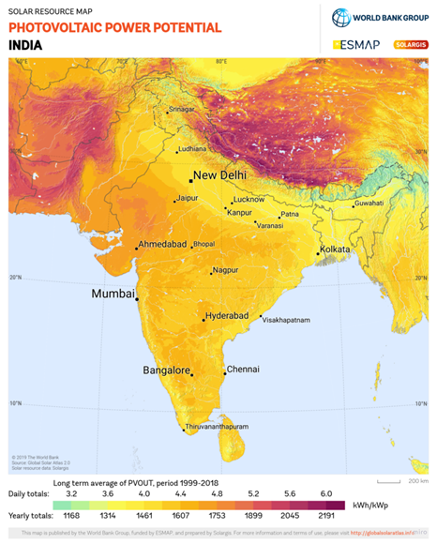
Photo-voltaic potential of India

Slide 15
Background Research
Energy Data Study for Nigeria:
On the global stage, Nigeria holds the 86th position in terms of solar power capacity installation (IRENA, 2022).
World Bank data (2023) indicates that 43% of Nigeria's population grapples with persistent power cuts.
Nigeria's installed electricity generation capacity stands at approximately 13,427 MW. However, the actual generation often falls significantly lower, averaging around 4,500 MW in 2022, as reported by the Federal Ministry of Power Nigeria.
This disparity between capacity and generation is primarily attributed to aging infrastructure, poor maintenance practices, and inadequate investment in the power sector (World Bank, 2022).

Slide 16
Background Research
Electricity distribution poses a challenge, with transmission and distribution losses estimated to be around 40%, as per the Federal Ministry of Power (2023).
Despite having abundant solar energy potential, with an average daily solar radiation of 5.08 KWh/m²/day, the adoption of solar power remains low. In 2022, only about 0.2% of Nigeria's electricity was sourced from solar, mainly due to the high upfront cost of solar panels, limited access to financing, and a lack of awareness regarding the benefits of solar power.
As an alternative, generators are widely used for energy backup in Nigeria, with an estimated 25 million generators in use, according to World Bank data (2022).
The use of generators in Nigeria results in the emission of over 20 million tons of carbon dioxide annually, equivalent to the emissions from approximately 10 million cars.

Slide 17
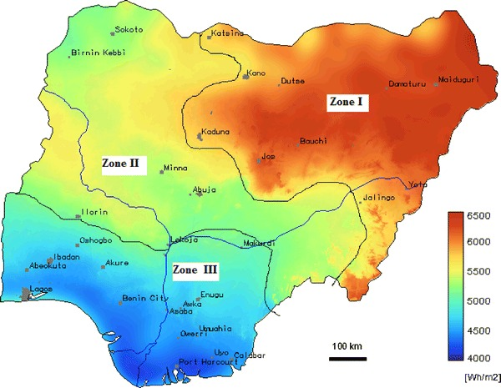
Photo-voltaic potential of Nigeria

Slide 18
Background Research
Governmental Outlook and Support:
In support of the national solar mission and clean-energy initiatives, the Indian government has allocated $130 million to the cause.
Nigeria has set a target to generate 30% of its electricity from renewable sources by 2030, as outlined by the Federal Ministry of Power in 2021.
To encourage the adoption of solar power, India provides subsidies for rooftop solar panel installations as part of its incentive programs.
In Nigeria, the government promotes solar power adoption through various initiatives, including tax incentives and financing schemes.
International organizations, including the World Bank, are actively providing financial and technical support to Nigeria to enhance its electricity infrastructure and promote the development of renewable energy.
India boasts a manufacturing capacity of 4.3 GW for solar cells and 18 GW for solar modules.

Slide 19
Background Research
Impact of Blackouts and Natural Disasters:
Approximately 43% of the Nigerian population experiences regular power outages.
In India, frequent and widespread power outages affect a substantial portion of households, with an estimated 34% reporting power cuts as of 2022.
These blackouts impede daily activities, hinder economic growth, and have a profound impact on essential services such as healthcare and education.
India contends with various natural disasters, including flooding, cyclones, earthquakes, and landslides.
Similarly, Nigeria faces natural disasters like floods, droughts, and oil spillage, posing significant threats to lives, livelihoods, and infrastructure.

Slide 20
Background Research
Impact of Gamification on Gardening:
The incorporation of gamification into gardening provides individuals with a sense of progress and accomplishment, fostering motivation through the completion of tasks and achievement of goals.
Essential elements of gamification, such as reward tokens and leaderboards, contribute to making gardening and agriculture enjoyable, attracting a broader audience to participate.
The gamified system effectively encourages users to enhance the quality of their plants and crops by cultivating interest and progression in their daily tasks.
Notable examples of gamification in gardening and agriculture can be observed in applications like Plantix, GardenTags, and Carrot Rewards.

Slide 21
Research Conclusion
The research delved into India and Nigeria's solar energy landscape, evaluating key aspects such as capacity, government support, challenges like blackouts and natural disasters, and the influence of Gamification on gardening. India, ranking fourth globally in solar energy generation, faces challenges like demand-supply shortages and frequent power outages affecting 85% of households. Bengaluru's rebate initiatives highlight local efforts. In Nigeria, ranked 86th in solar capacity, persistent power cuts and reliance on generators pose hurdles. Both countries receive government support, with India allocating $130 million and Nigeria targeting 30% renewable energy by 2030. Challenges include power outages affecting 43% in Nigeria and 34% in India. Gamification contributes to gardening motivation, with examples like Plantix and GardenTags.

Slide 22
Questionnaire Design
To enhance the efficiency of our requirements gathering process and gain insights into user preferences, we formulated a survey with targeted questions. This survey was distributed across India and Nigeria through popular social platforms such as WhatsApp, Instagram, and Facebook. The questionnaire covered sections that aimed to gather information related to demographics, budget considerations, and interest in adopting renewable sources.
After internal evaluation, we commenced sharing the survey to collect responses. Subsequent slides delve into specific questions that served as crucial data points for refining the application's features. Additionally, this process helped identify unnecessary survey questions. Survey Link : Form Link

Slide 23
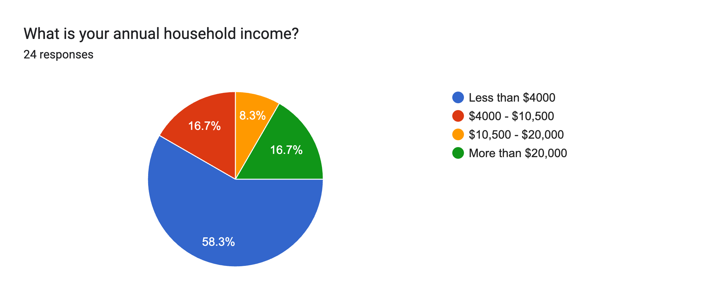
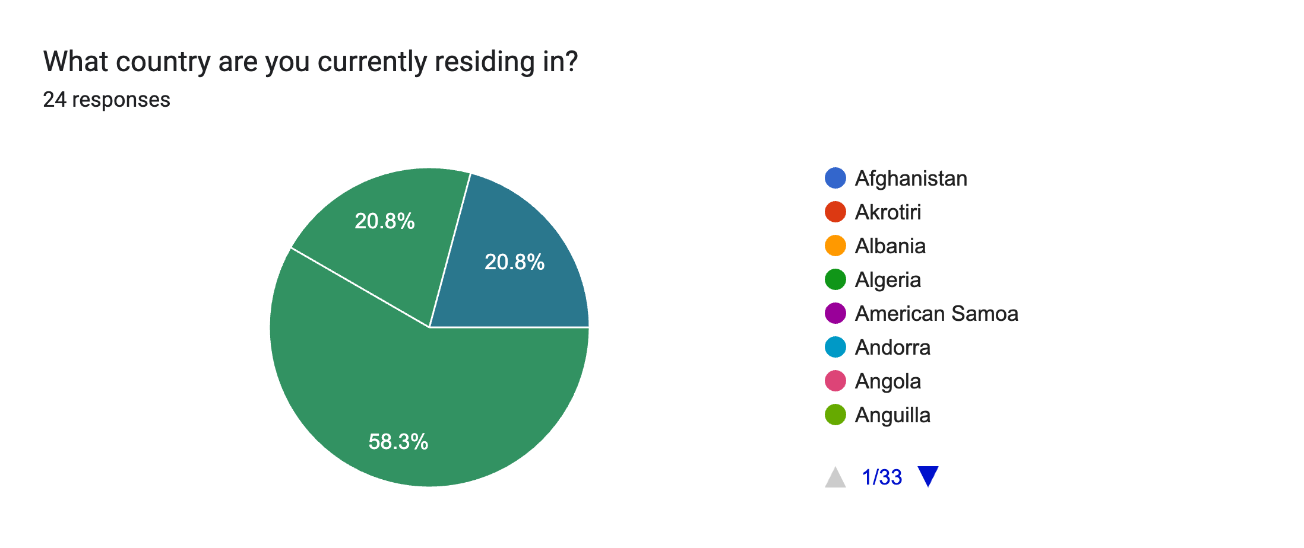
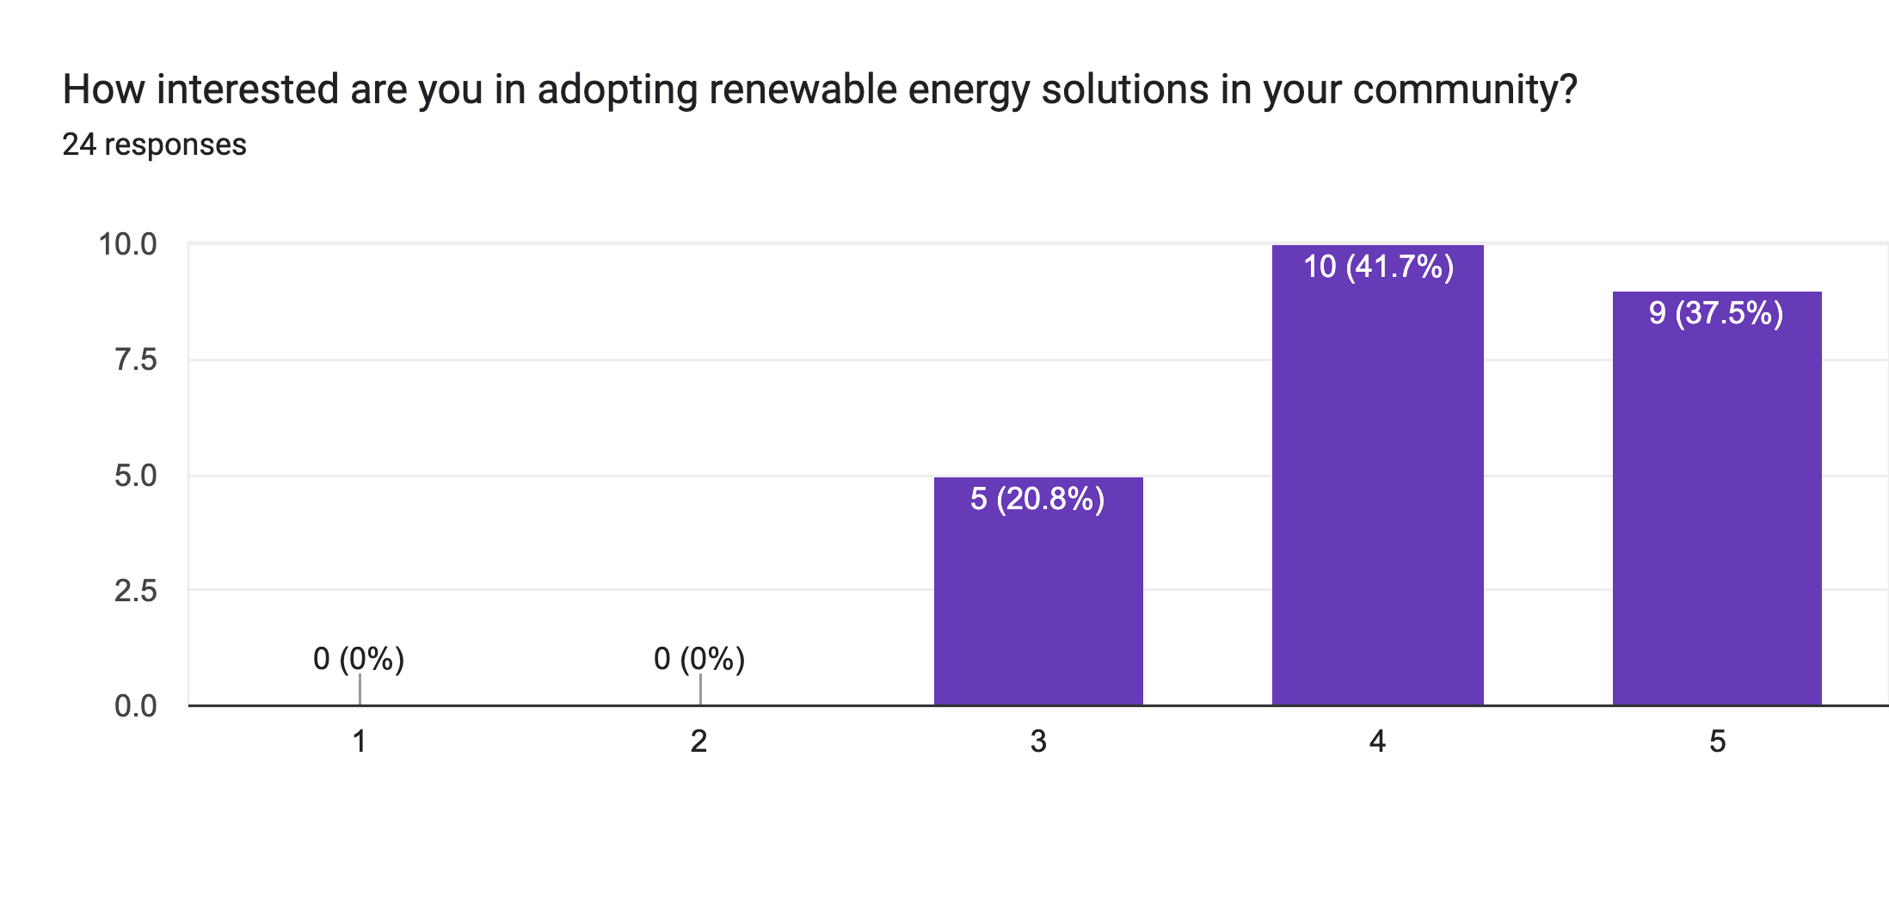
Questionnaire Results
The initial chart depicting annual household income reveals that a significant portion of survey participants earns less than $4000 annually, a sum deemed adequate for metropolitan living in India and Nigeria. The escalating costs of conventional electricity sources appear to be consuming a considerable portion of their income. This circumstance might be a driving factor behind their inclination towards the adoption of solar power, whether for sale, purchase, or a combination of both.
In the second graph, the survey's demographic breakdown indicates that 58.3% of respondents are from India, while 20.8% each are from Nigeria and the United Kingdom. The UK respondents, primarily students, pose challenges in determining their origin.
The third graph highlights a prevalent interest among surveyed individuals in embracing renewable energy solutions for their communities, with a majority expressing a strong inclination, as evident in the most likely category.

Slide 24
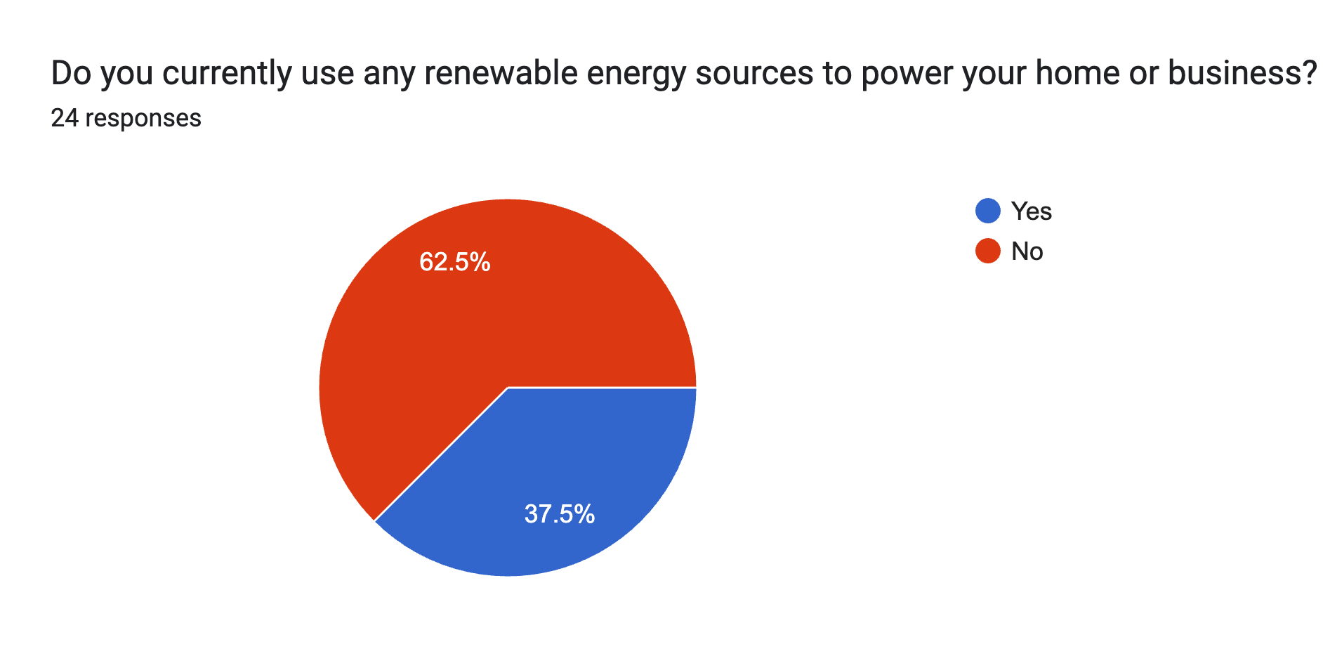
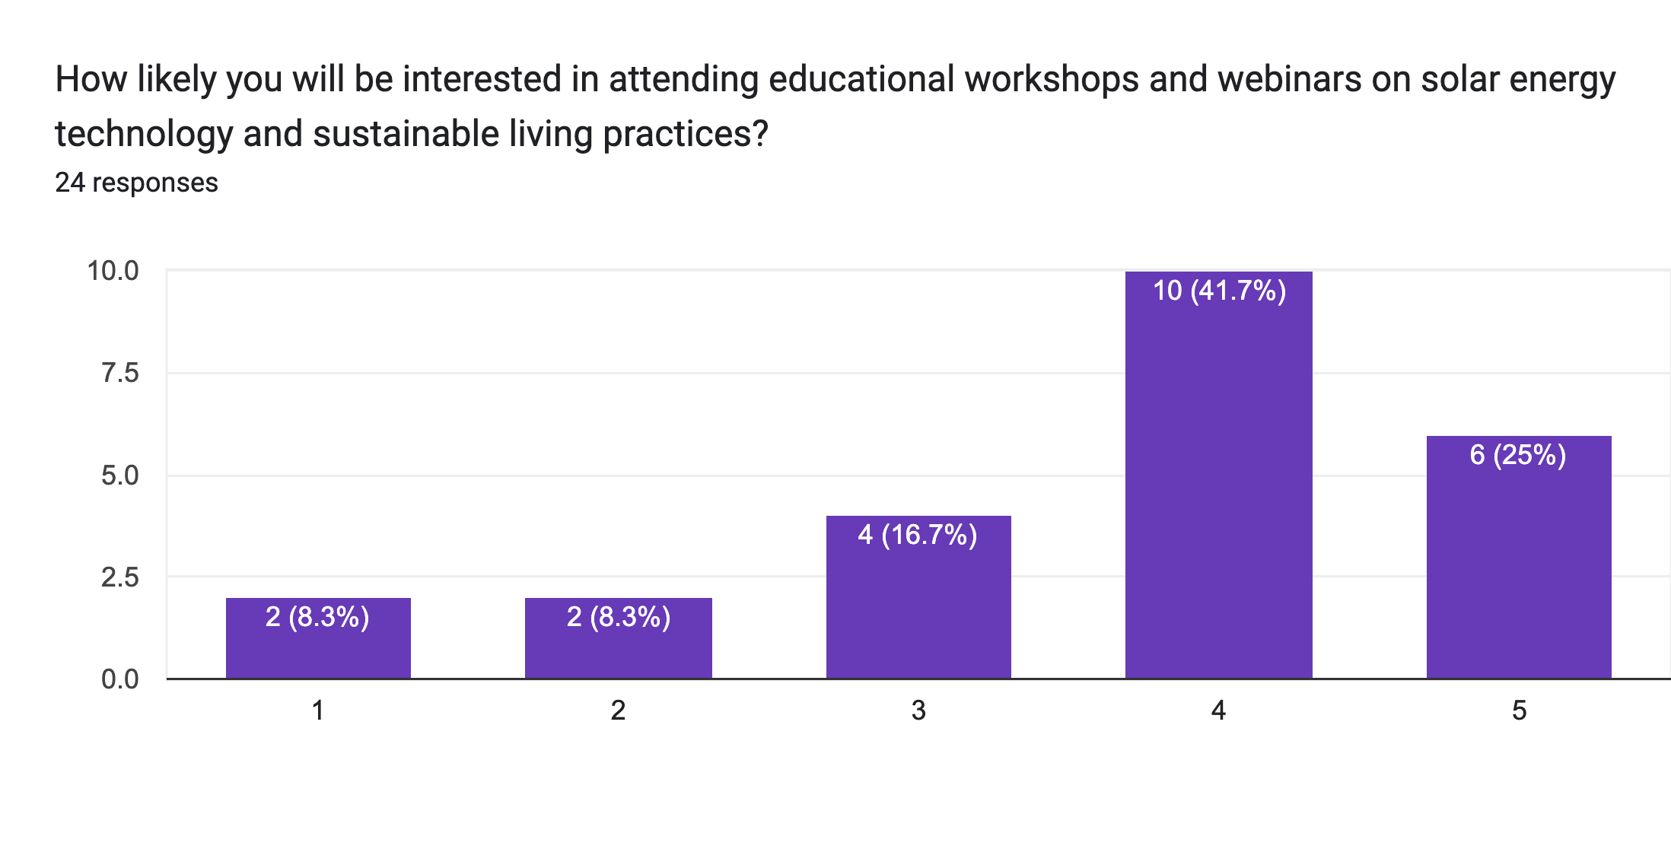
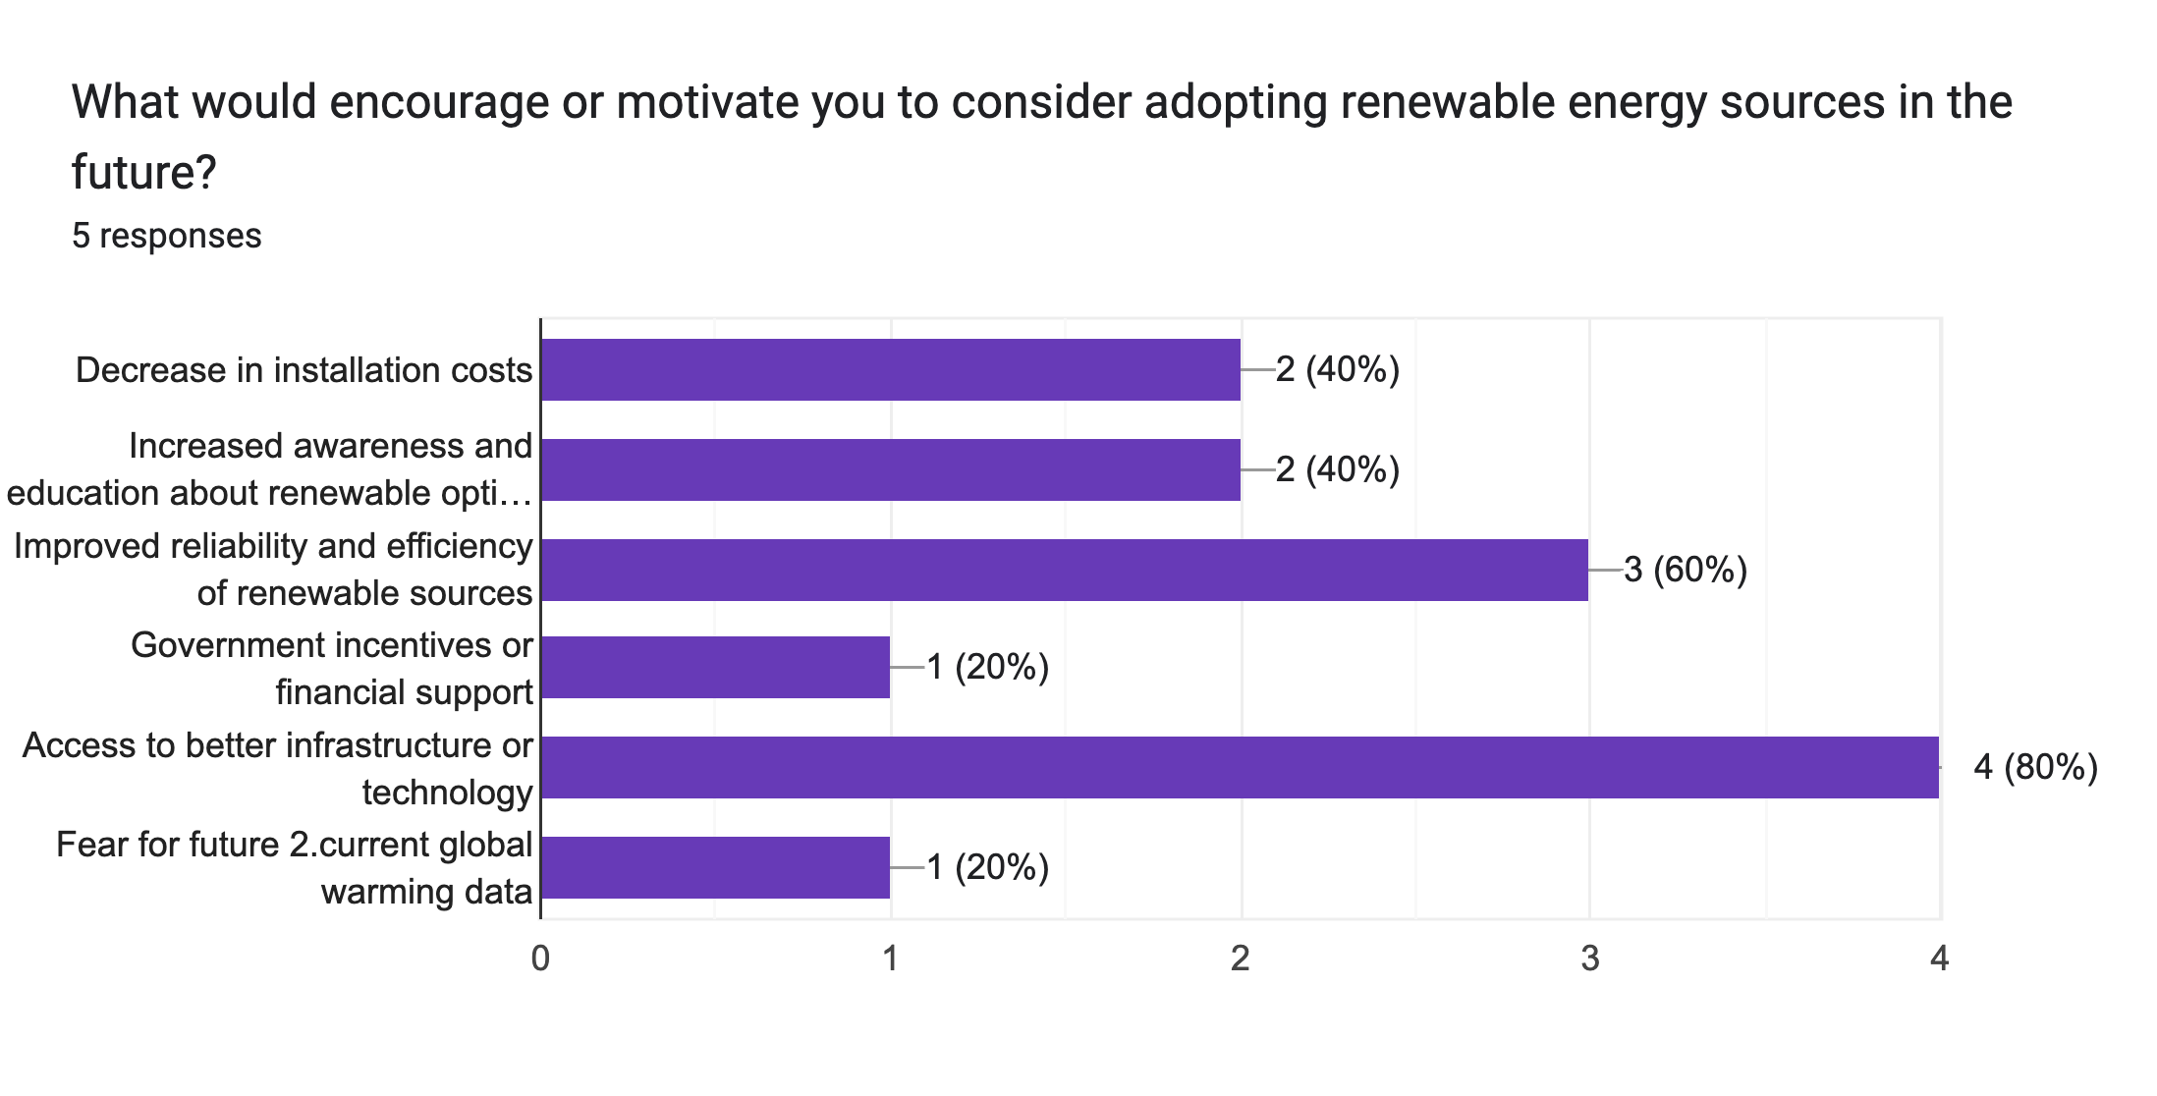
Questionnaire Results
The initial graph indicates that most participants currently do not incorporate any form of renewable sources in their homes or businesses. This significant gap suggests a favorable acceptance for our application, especially with effective awareness campaigns.
The second graph reveals an interest among individuals to participate in workshops and campaigns aiming to provide comprehensive insights into the implementation of solar energy solutions in their sustainable daily practices, along with the underlying technology.
Factors such as improved infrastructure and technology access, enhanced reliability and efficiency of renewable sources, reasonable installation costs, and heightened awareness serve as strong motivators for individuals. Notably, government incentives, as outlined in the third graph, rank lower in participants' concerns.
95.8%
Participants between 18-65

Slide 25
Yes. It cost a lot at time of installation, but it save a lot of money in future and now there is no fear of power cut at emergency time. - participant answer
Do you believe that using renewable energy sources is feasible or suitable for your specific living or working conditions? Please explain.

Slide 26
03
PHASE 3 Scenarios, UML, Sketches, Wireframes, Prototypes,

Slide 27
04
PHASE 4 Mockups, Poster, Team, Work and Group Management

Slide 28
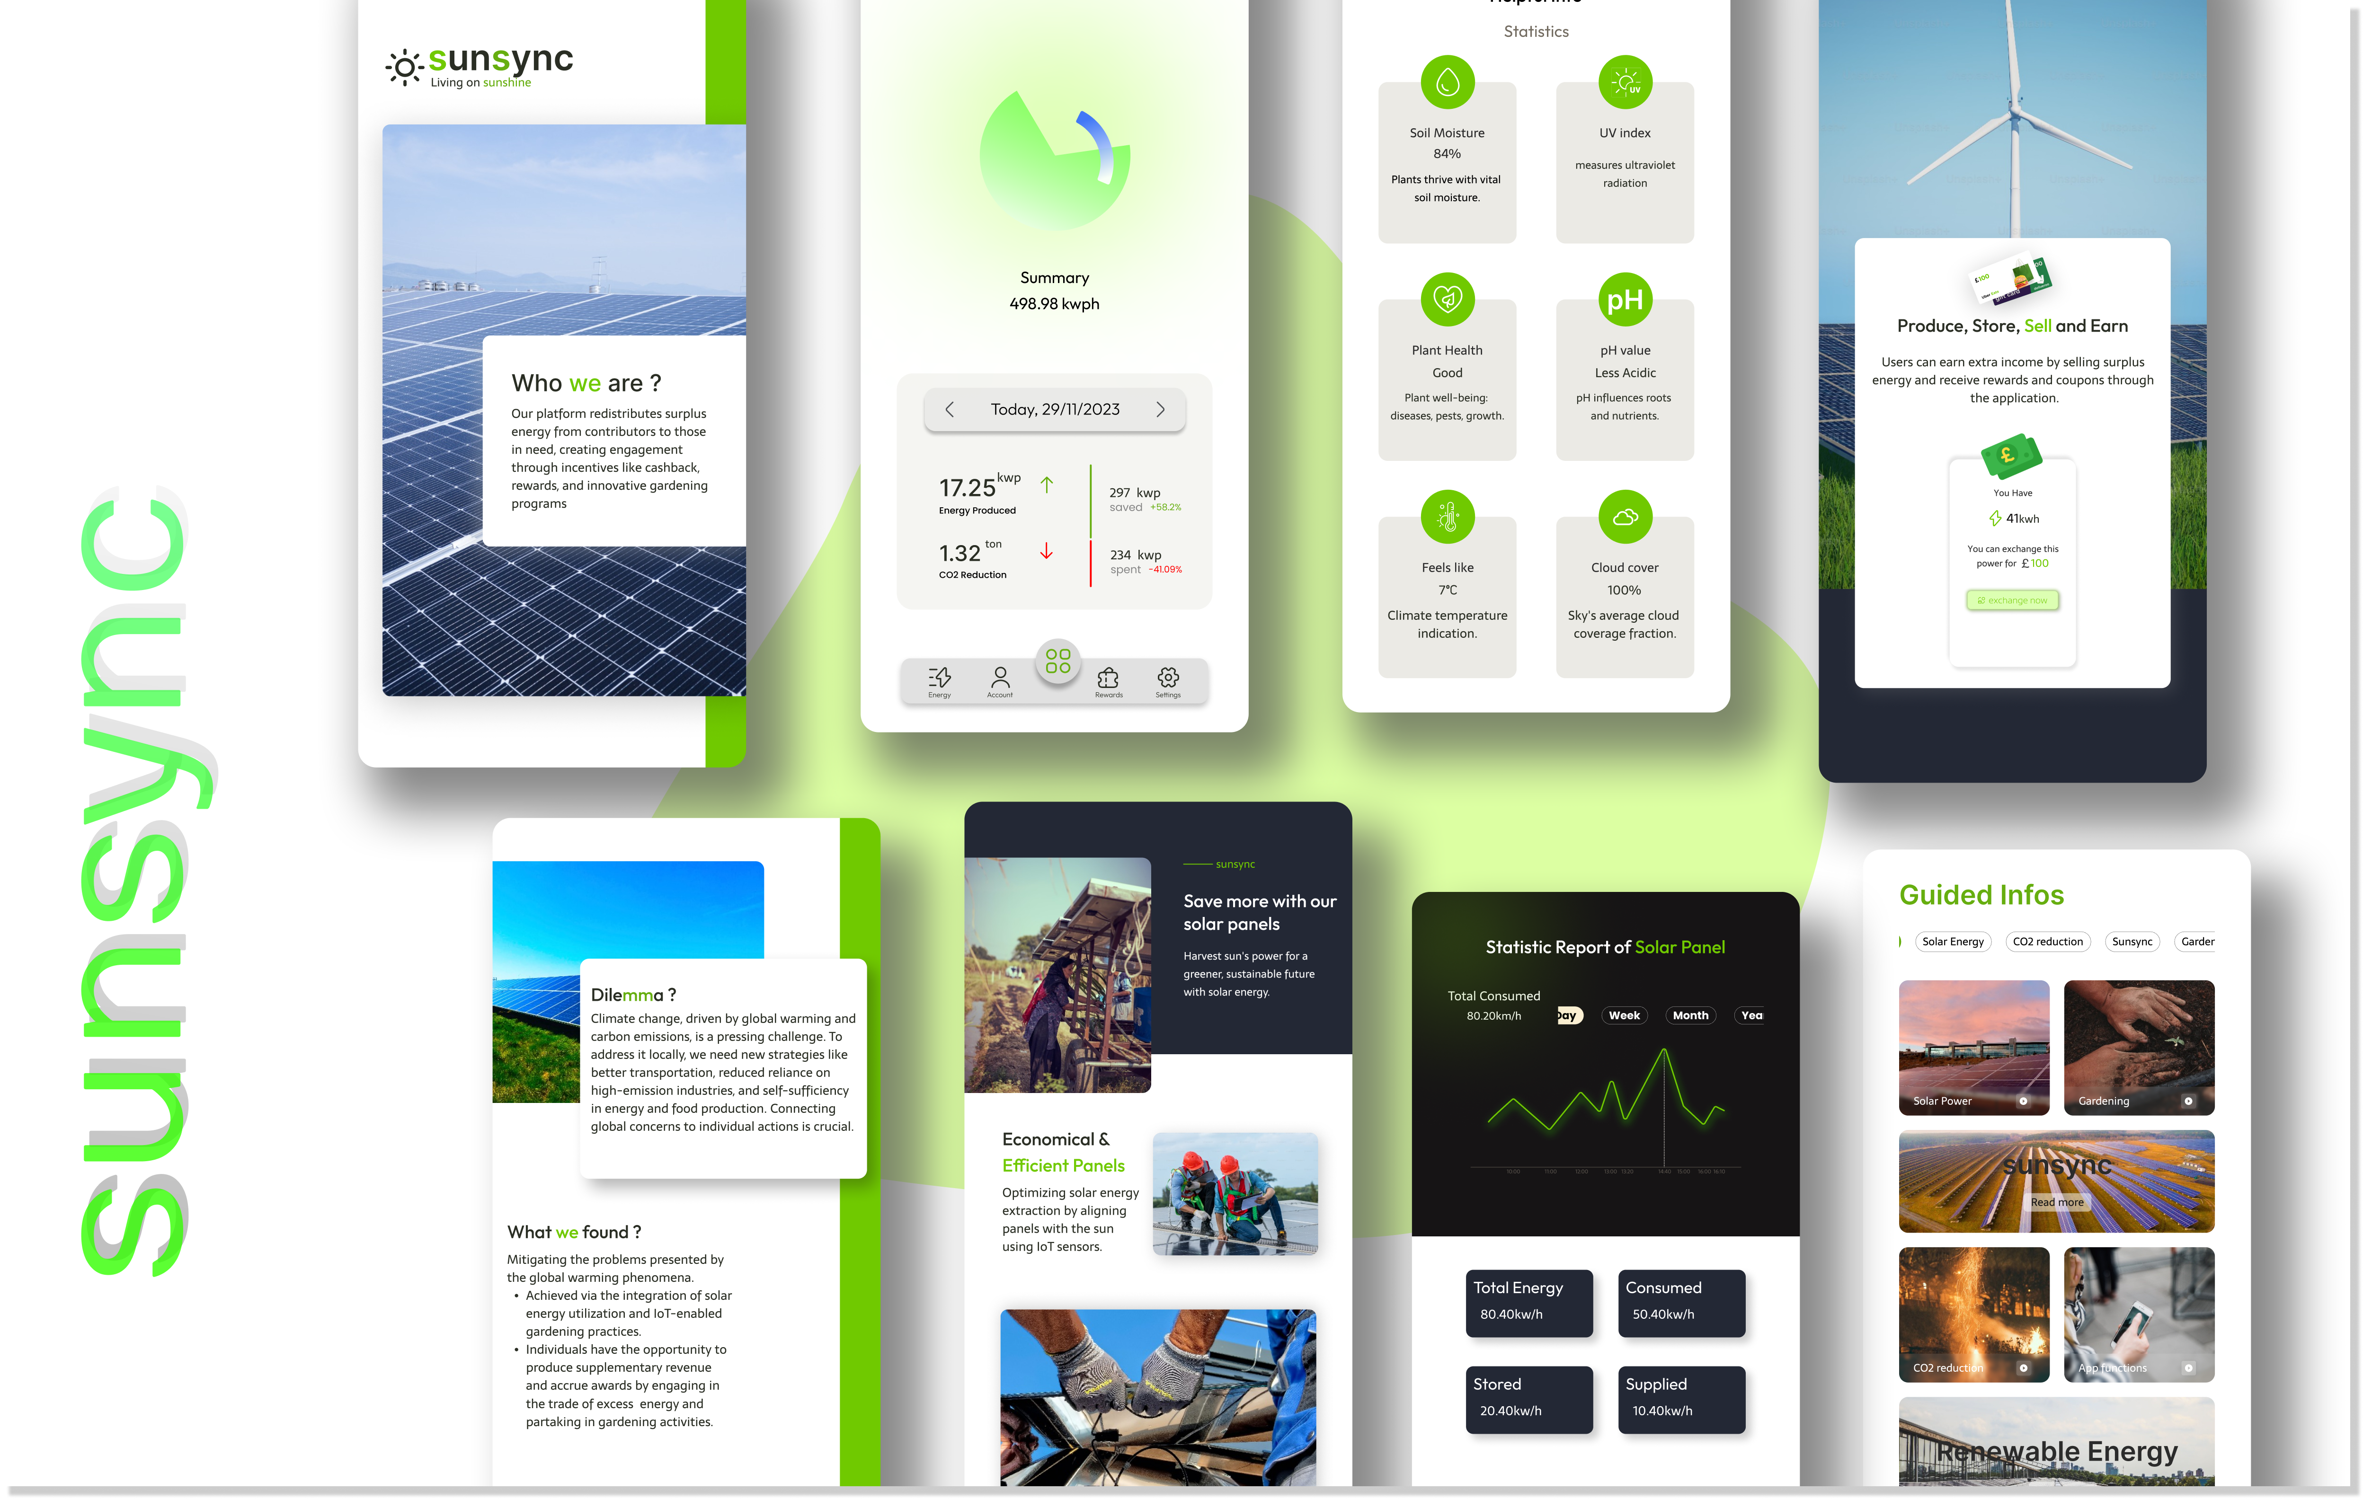
FINAL POSTER DESIGN

Slide 29




OUR TEAM
Durgesh Nandan
Oseni Malik
Ashutosh Panda
Rohan Bhujbal
Group Coordinator
Application Developer and Design Architect
UI/UX Designer
Data Gathering and Content Writing

Slide 30
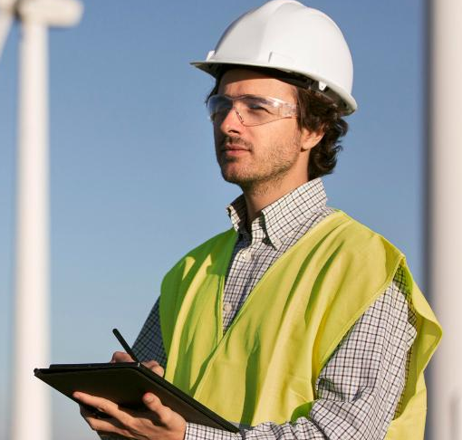
OUR TEAM
Vedant Parab
Contributor

Slide 31
Division Of Work
We outlined the preferences and strengths of each team member and tailored user stories based on their skill sets. Each user story focused on a singular task. To ensure effective collaboration, we utilized a Trello board resembling a scrum board to monitor the progress of each story and track its stage.
Ashutosh, leveraging his expertise in UI/UX design, concentrated on tasks like sketches, wireframes, and prototypes. Malik delved into architecture diagrams and feature briefs. Rohan, serving as the content writer, gathered essential data for the application requirements. As a Full Stack Development expert, Durgesh took on the role of project coordinator, contributing to design, architecture, research, and development. Vedant contributed in surveys and analysis.

Slide 32
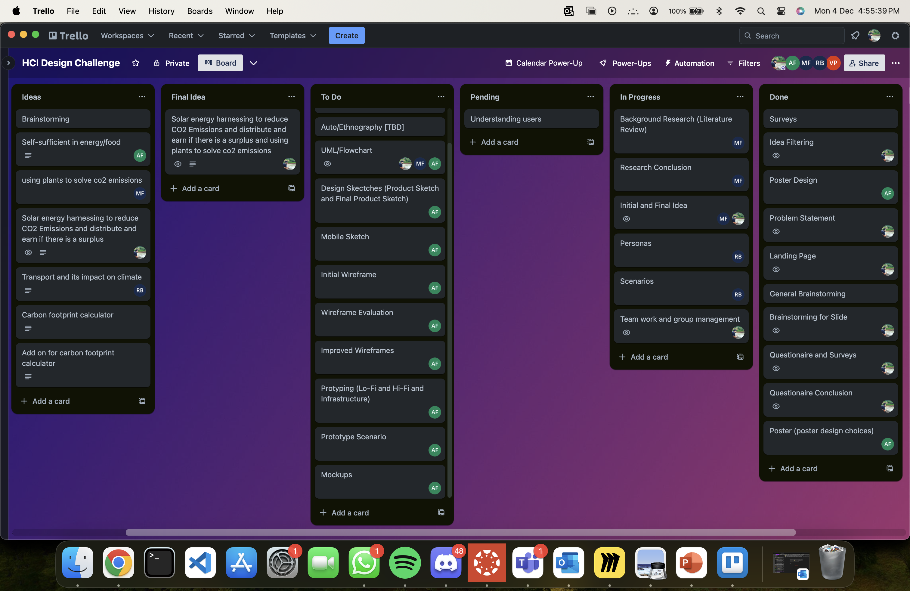
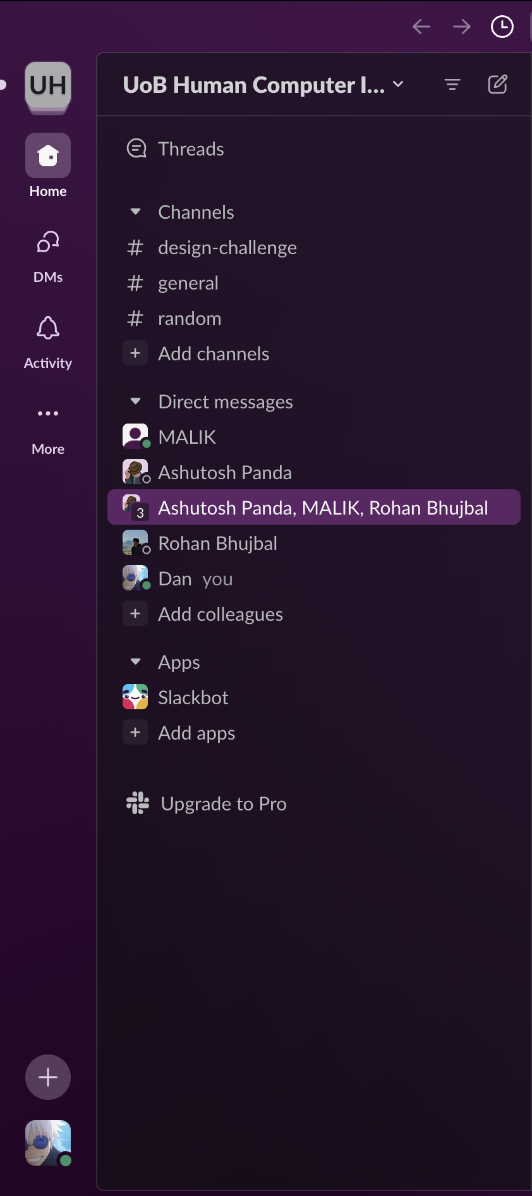
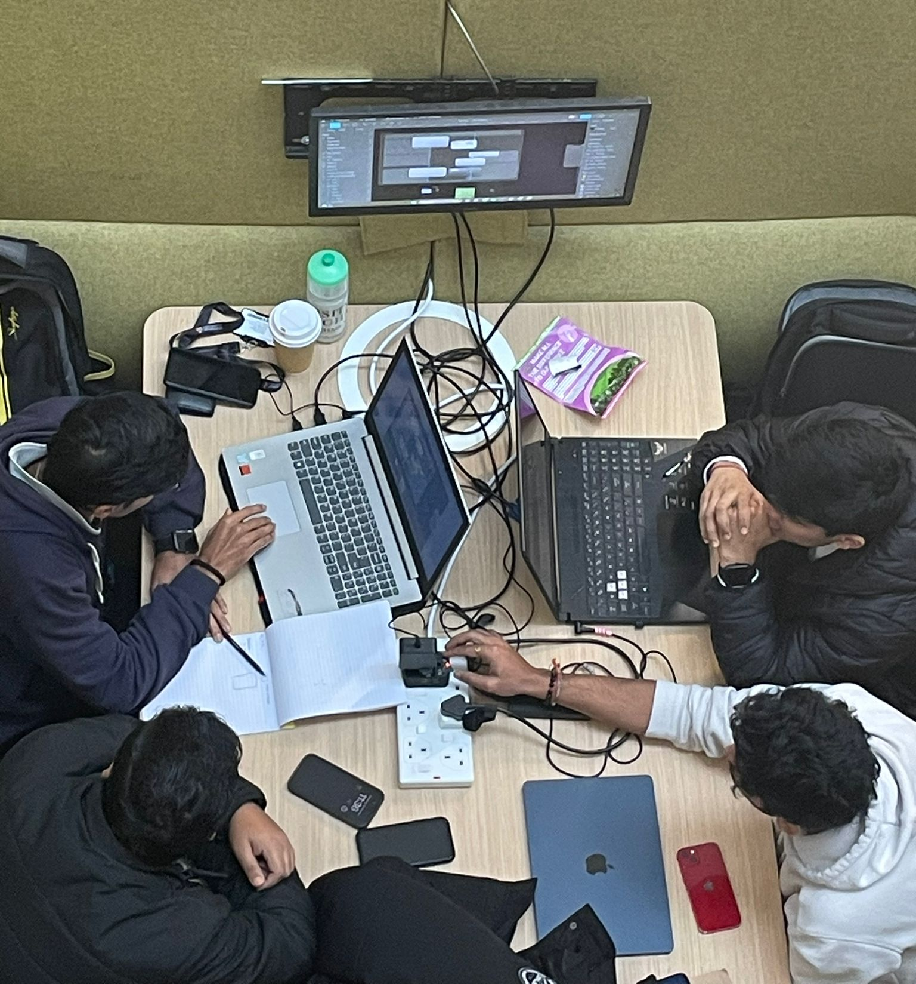
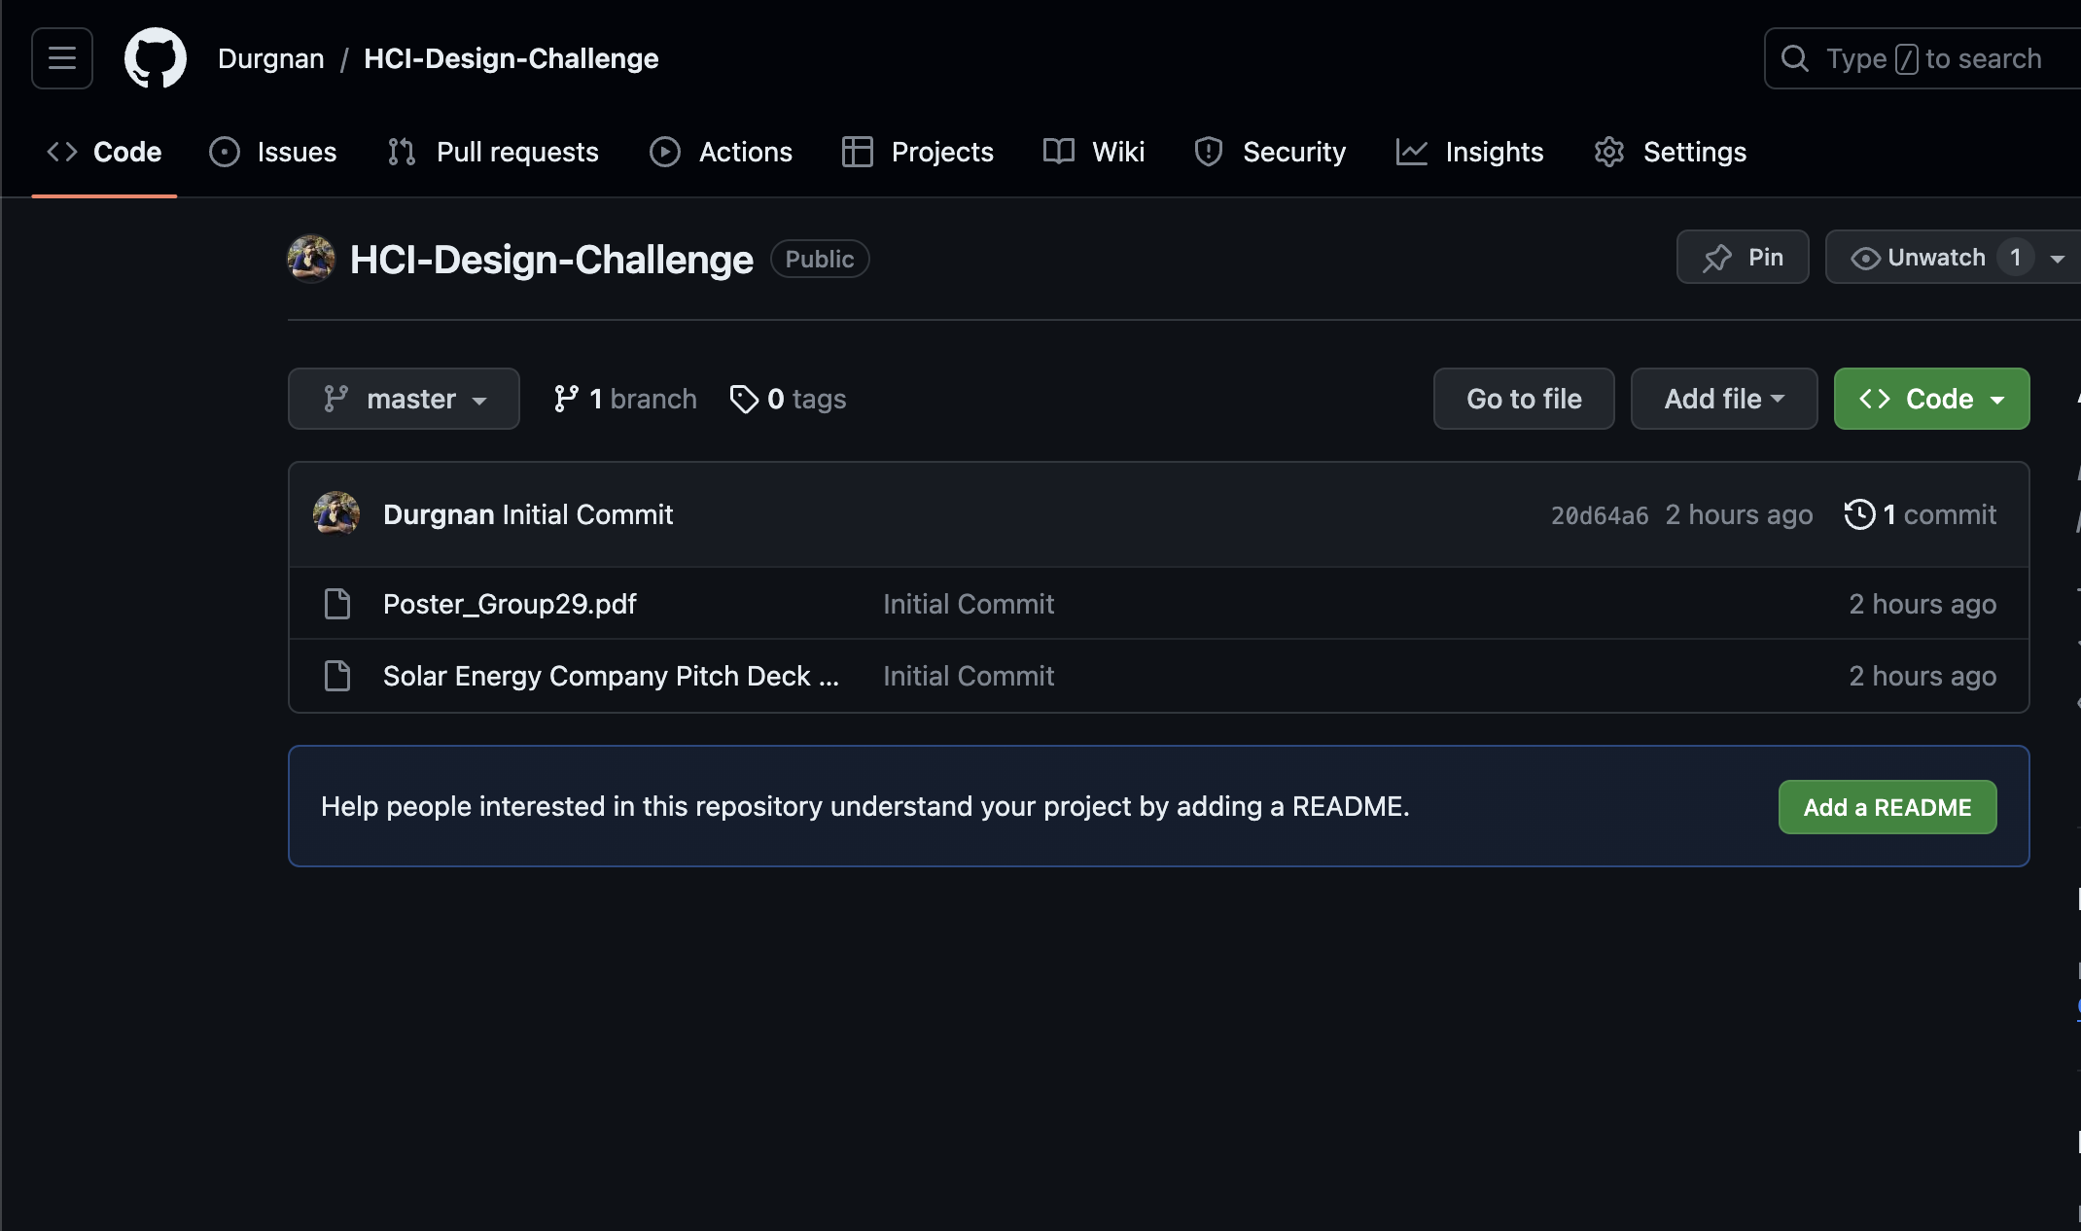
Group Work Management
The tools we used to work for our project is as follows:
Trello: User Stories tracking
Slack: chat workspace and a place for scheduled and adhoc calls.
GitHub: to maintain and manage changes of all the documents and codes in a safe repository.
Figma: For wireframing and prototyping
Miro: For brainstorming ideas and research

Slide 33
INTRODUCTION
SOLAR ENERGY COMPANY - SOLAR ENERGY COMPANY - SOLAR ENERGY COMPANY
Mercury is the closest planet to the Sun and the smallest one in the Solar System—it’s only a bit larger than the Moon. The planet’s name has nothing to do with the liquid metal, since Mercury was named after the Roman messenger god
SOLAR ENERGY COMPANY - SOLAR ENERGY COMPANY - SOLAR ENERGY COMPANY

Slide 34
OUR COMPANY
Mercury is the closest planet to the Sun and the smallest one in the Solar System—it’s only a bit larger than the Moon. The planet’s name has nothing to do with the liquid metal
OUR COMPANY - OUR COMPANY - OUR COMPANY - OUR COMPANY - OUR COMPANY - OUR COMPANY

Slide 35
CONTENTS OF THIS TEMPLATE
This is a slide structure based on a pitch deck presentation
You can delete this slide when you’re done editing the presentation
FONTS | To view this template correctly in PowerPoint, download and install the fonts we used
USED AND ALTERNATIVE RESOURCES | An assortment of graphic resources that are suitable for use in this presentation
THANKS SLIDE | You must keep it so that proper credits for our design are given
COLORS | All the colors used in this presentation
INFOGRAPHIC RESOURCES | These can be used in the template, and their size and color can be edited
CUSTOMIZABLE ICONS | They are sorted by theme so you can use them in all kinds of presentations
For more info: SLIDESGO | SLIDESGO SCHOOL | FAQS
You can visit our sister projects: FREEPIK | FLATICON | STORYSET | WEPIK | VIDFY
CONTENTS OF THIS TEMPLATE - CONTENTS OF THIS TEMPLATE - CONTENTS OF THIS TEMPLATE

Slide 36
THEM
US
Mercury is the closest planet to the Sun and the smallest one in the Solar System—it’s only a bit larger than the Moon
Venus has a beautiful name and is the second planet from the Sun. It’s hot and has a poisonous atmosphere
SOLAR ENERGY COMPANY - SOLAR ENERGY COMPANY - SOLAR ENERGY COMPANY

Slide 37
320,000
SOLAR ENERGY COMPANY - SOLAR ENERGY COMPANY
Big numbers catch your audience’s attention
SOLAR ENERGY COMPANY - SOLAR ENERGY COMPANY

Slide 38
SOLUTION
Venus has a beautiful name and is the second planet from the Sun. It’s terribly hot—even hotter than Mercury—and its atmosphere is extremely poisonous
SOLUTION - SOLUTION - SOLUTION - SOLUTION - SOLUTION - SOLUTION

Slide 39
SWOT ANALYSIS
STRENGTHS
WEAKNESSES
OPPORTUNITIES
THREATS
S
Mercury is the smallest planet of them all
W
Venus has a beautiful name, but also high temperatures
O
Earth is the beautiful planet where we all live on
T
Despite being red, Mars is actually a cold place
SWOT ANALYSIS - SWOT ANALYSIS - SWOT ANALYSIS
SWOT ANALYSIS - SWOT ANALYSIS - SWOT ANALYSIS - SWOT ANALYSIS

Slide 40
PRODUCT OVERVIEW
MERCURY
VENUS
EARTH
MARS
SATURN
Mercury is the smallest planet of them all
Venus is the second planet from the Sun
Earth is the only planet known to harbor life
Despite being red, Mars is actually a cold place
Saturn is not the only planet with rings
PRODUCT OVERVIEW - PRODUCT OVERVIEW - PRODUCT OVERVIEW

Slide 41
OUR PLANS
BASIC
PRO
PREMIUM
$10,000
$19,000
$26,000
Mercury is the closest planet to the Sun and the smallest of them all
Venus has a beautiful name and is the second planet from the Sun
Despite being red, Mars is actually a cold place. It's full of iron oxide dust
OUR PLANS - OUR PLANS - OUR PLANS - OUR PLANS - OUR PLANS - OUR PLANS

Slide 42
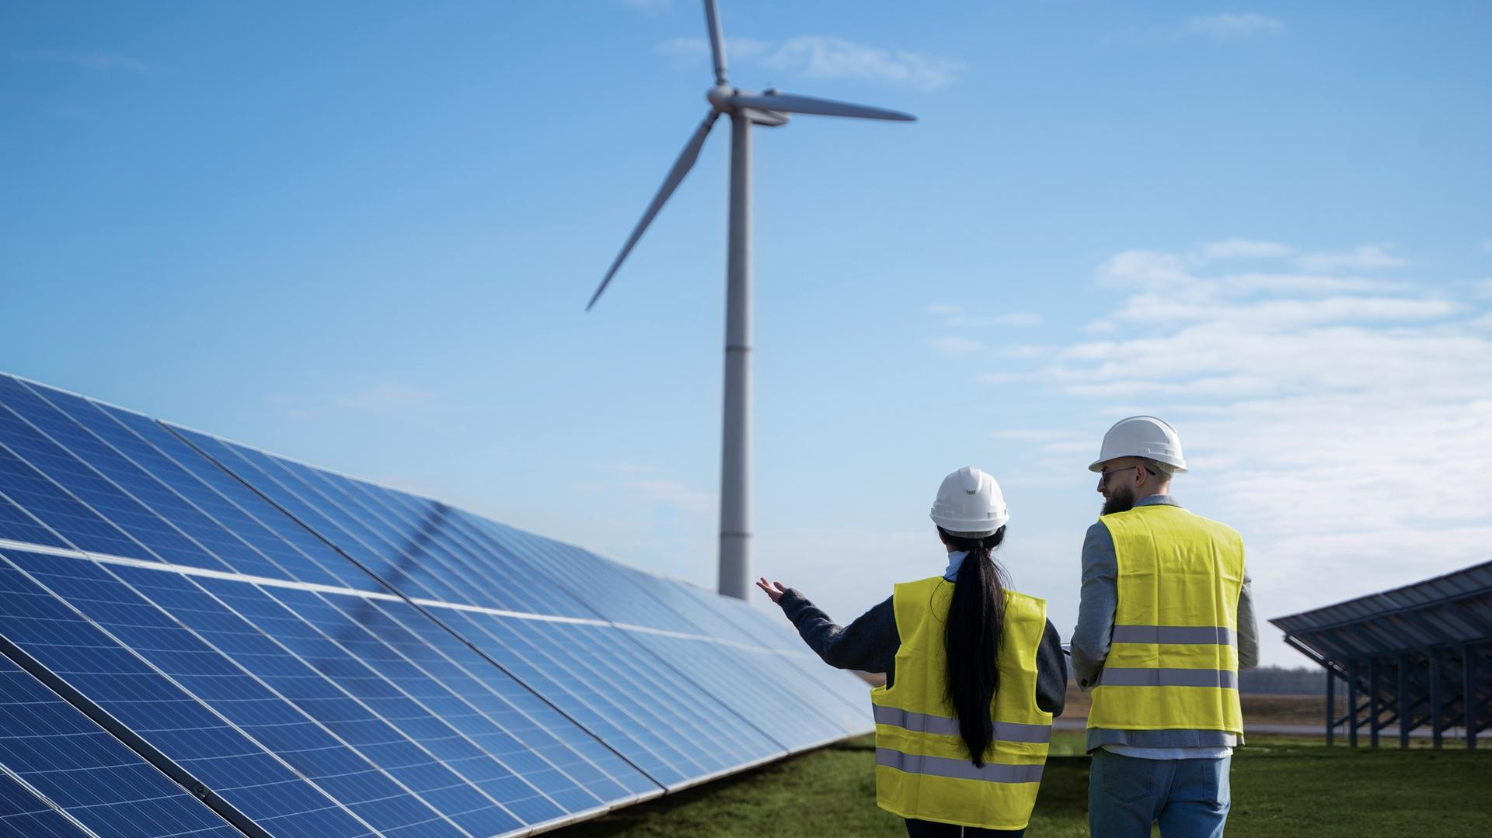
A PICTURE IS WORTH A THOUSAND WORDS
SOLAR ENERGY COMPANY - SOLAR ENERGY COMPANY - SOLAR ENERGY COMPANY
SOLAR ENERGY COMPANY - SOLAR ENERGY COMPANY - SOLAR ENERGY COMPANY

Slide 43
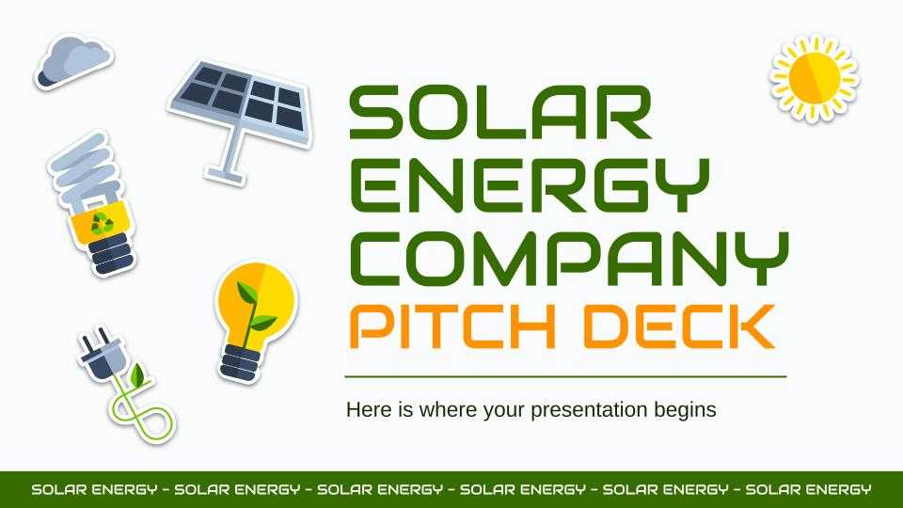
PRODUCT DEMO
You can replace the image on the screen with your own work. Just right-click on it and select “Replace image”
SOLAR ENERGY COMPANY - SOLAR ENERGY COMPANY

Slide 44
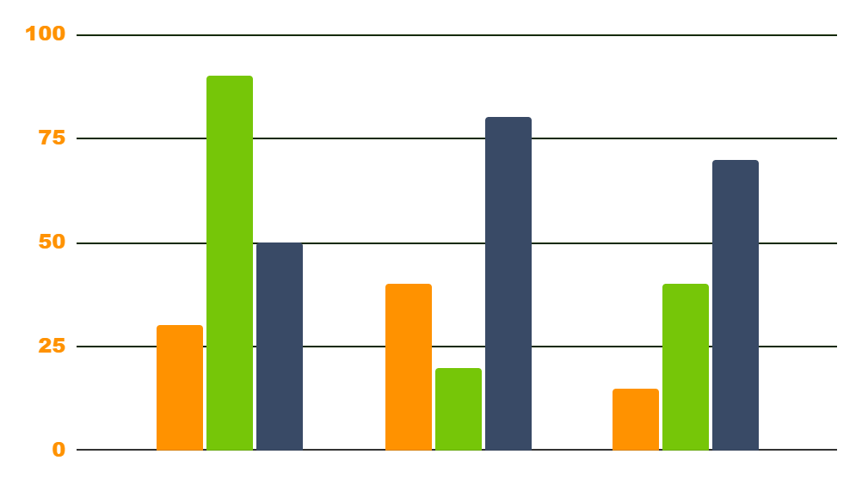
TRACTION
$140,000
12,000
$150
150,000,00$
JUPITER
VENUS
MARS
Gross revenues in 2021
Gross revenue in 2020
Registered businesses
Home energy savings
Follow the link in the graph to modify its data and then paste the new one here. For more info, click here
TRACTION - TRACTION - TRACTION - TRACTION - TRACTION - TRACTION - TRACTION

Slide 45
AWESOME WORDS
SOLAR ENERGY COMPANY - SOLAR ENERGY COMPANY
SOLAR ENERGY COMPANY - SOLAR ENERGY COMPANY

Slide 46
CASE STUDY
CHALLENGE
BUDGET
RESULTS
SOLUTIONS
Despite being red, Mars is actually a cold place full of iron oxide dust
Jupiter is a gas giant and the biggest planet in the entire Solar System
Venus has a beautiful name and is the second planet from the Sun
Saturn is a gas giant, composed mostly of hydrogen and helium
CASE STUDY - CASE STUDY - CASE STUDY - CASE STUDY - CASE STUDY

Slide 47


REVIEWS
NICOLE WILLS
RON SMITH
“Mercury is the closest planet to the Sun and the smallest one in the Solar System”
“Jupiter is the biggest planet in the Solar System and the fourth-brightest object in the sky”
REVIEWS - REVIEWS - REVIEWS - REVIEWS - REVIEWS - REVIEWS - REVIEWS

Slide 48
LATEST AWARDS
MERCURY
JUPITER
NEPTUNE
Mercury is the smallest planet of them all
Jupiter is the biggest planet of them all
Neptune is the farthest planet from the Sun
AWARDS - AWARDS - AWARDS - AWARDS - AWARDS - AWARDS - AWARDS - AWARDS

Slide 49
—SOMEONE FAMOUS
SOLAR ENERGY COMPANY - SOLAR ENERGY COMPANY
“This is a quote, words full of wisdom that someone important said and can make the reader get inspired.”
SOLAR ENERGY COMPANY - SOLAR ENERGY COMPANY

Slide 50
MARKET SIZE
60%
40%
MERCURY
VENUS
Mercury is the closest planet to the Sun
Venus is the second planet from the Sun
MARKET SIZE - MARKET SIZE - MARKET SIZE - MARKET SIZE - MARKET SIZE - MARKET SIZE

Slide 51
TARGET
$200
AGE
SPEND PER CUSTOMER
10%
50%
40%
Venus has a beautiful name, but also high temperatures
23 - 30
31 - 45
46+
GENDER
INTERESTS
Man
30%
Devices
Home
Woman
50%
Others
20%
Savings
Transportation
TARGET - TARGET - TARGET - TARGET - TARGET - TARGET - TARGET - TARGET - TARGET

Slide 52
OUR COMPETITORS
 | COMPETITOR A | COMPETITOR B | COMPETITOR C
DESCRIPTION | Mercury is the smallest planet of them all | Venus is terribly hot, even hotter than Mercury | Phobos and Deimos are both Mars’s moons
CHARACTERISTIC | Despite being red, Mars is actually a cold place | Jupiter is a gas giant planet in the Solar System | Saturn is a gas giant and has several rings
PRODUCT | Neptune is the farthest planet from the Sun | Earth is where we all live on and a blue planet | The Sun is the star at the center of the Solar System
COMPETITORS - COMPETITORS - COMPETITORS - COMPETITORS - COMPETITORS

Slide 53
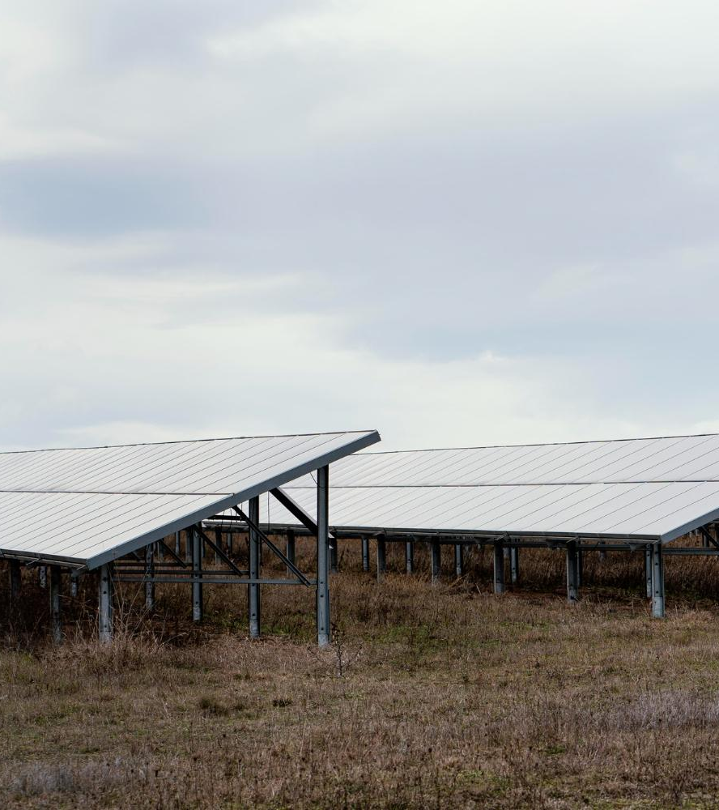
A PICTURE ALWAYS REINFORCES THE CONCEPT
SOLAR ENERGY COMPANY - SOLAR ENERGY COMPANY - SOLAR ENERGY COMPANY
Images reveal large amounts of data, so remember: use an image instead of a long text. Your audience will appreciate it
SOLAR ENERGY COMPANY - SOLAR ENERGY COMPANY - SOLAR ENERGY COMPANY

Slide 54
BUSINESS MODEL
SATURN
EARTH
JUPITER
VENUS
MARS
MERCURY
Saturn is not the only planet with rings
Earth is the only planet known to harbor life
Jupiter is the biggest planet of them all
Venus is the second planet from the Sun
Despite being red, Mars is actually a cold place
Mercury is the smallest planet of them all
BUSINESS MODEL - BUSINESS MODEL - BUSINESS - BUSINESS - BUSINESS

Slide 55
TIMING
WEEK 01
WEEK 02
WEEK 03
WEEK 04
MARS
VENUS
SATURN
JUPITER
Despite being red, Mars is cold
Venus has a beautiful name
Saturn is a gas giant with rings
Jupiter is a very big planet
TIMING - TIMING - TIMING - TIMING - TIMING - TIMING - TIMING - TIMING - TIMING - TIMING

Slide 56
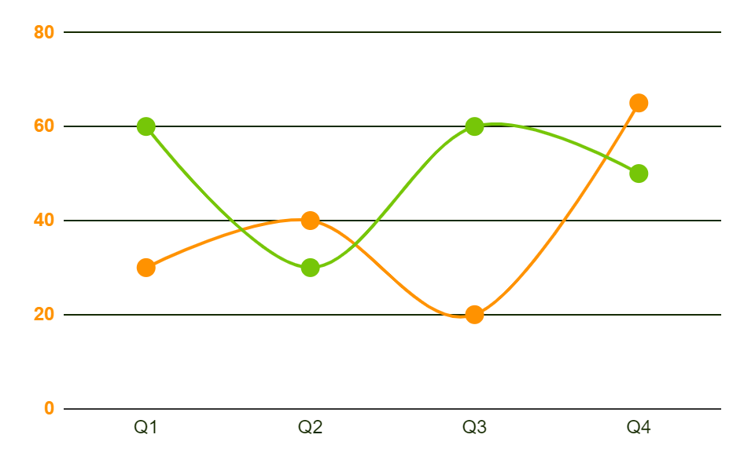
PREDICTED GROWTH
80%
$60M
Increased income
Expected income
65%
2,000
More employees
Total employees
Follow the link in the graph to modify its data and then paste the new one here. For more info, click here
PREDICTED GROWTH - PREDICTED GROWTH - PREDICTED GROWTH - PREDICTED GROWTH

Slide 57
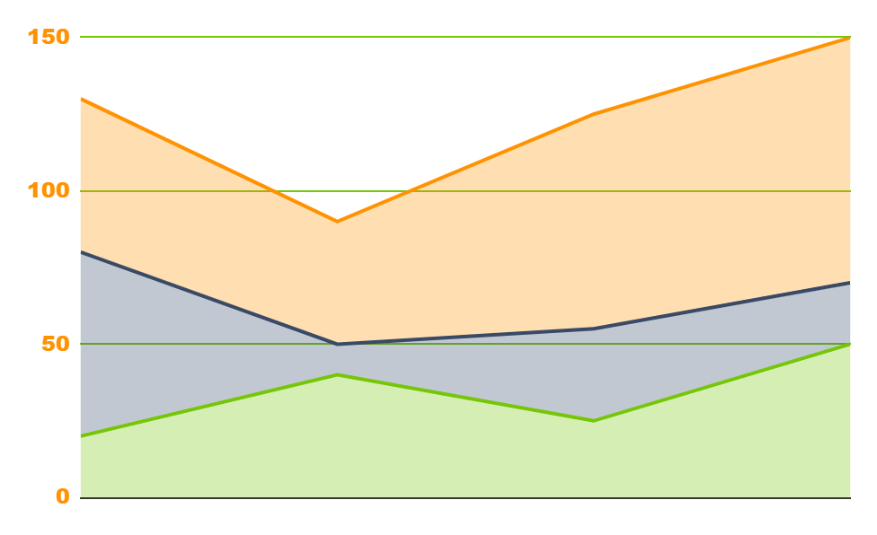
INVESTMENT
VENUS
20%
Venus is the second planet from the Sun
MARS
30%
Mars is full of iron oxide dust
EARTH
50%
Earth is the third planet from the Sun
2020
2021
2022
Follow the link in the graph to modify its data and then paste the new one here. For more info, click here
INVESTMENT - INVESTMENT - INVESTMENT - INVESTMENT - INVESTMENT - INVESTMENT

Slide 58
9h 55m 23s
333,000
386,000 km
SOLAR ENERGY COMPANY - SOLAR ENERGY COMPANY - SOLAR ENERGY COMPANY
Jupiter's rotation period
The Sun’s mass compared to Earth’s
Distance between Earth and the Moon
SOLAR ENERGY COMPANY - SOLAR ENERGY COMPANY - SOLAR ENERGY COMPANY

Slide 59
THANKS!
THANKS! - THANKS! - THANKS! - THANKS!
Do you have any questions?
addyouremail@freepik.com
+91 620 421 838
yourwebsite.com
Please keep this slide for attribution
THANKS! - THANKS! - THANKS! - THANKS!

Slide 60
ICON PACK
SOLAR ENERGY COMPANY - SOLAR ENERGY COMPANY

Slide 61
ALTERNATIVE RESOURCES
Here’s an assortment of alternative resources whose style fits the one of this template:
VECTORS
Eco energy flat icons
Isolated eco icon set
ALTERNATIVE RESOURCES - ALTERNATIVE RESOURCES - ALTERNATIVE RESOURCES

Slide 62
RESOURCES
Did you like the resources on this template? Get them for free at our other websites:
VECTORS
Ecology icons set
Eco energy flat icons
ICONS
Icon Pack: Ecology Test Task | Lineal color
PHOTOS
Portrait of a beautiful woman engineer
Medium shot smiley engineer holding tablet
Wind farms fields
Medium shot engineers discussing about solar panels
Field with lots of solar panels and copy space
Medium shot old man posing
Smiley woman looking at the phone with copy space
RESOURCES - RESOURCES - RESOURCES - RESOURCES - RESOURCES - RESOURCES

